Slide 1
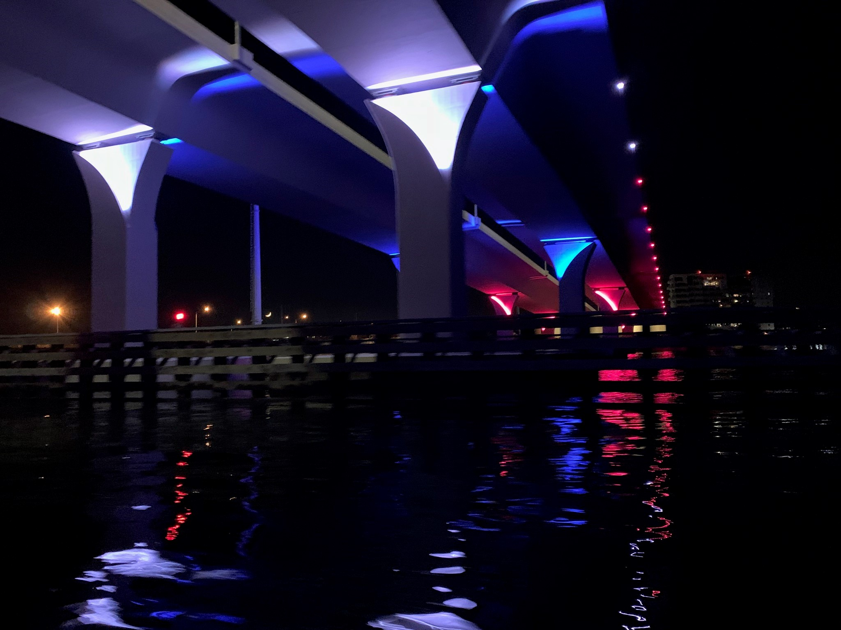
Lesner Bridge Aesthetic Lighting
Program Descriptions

Slide 2
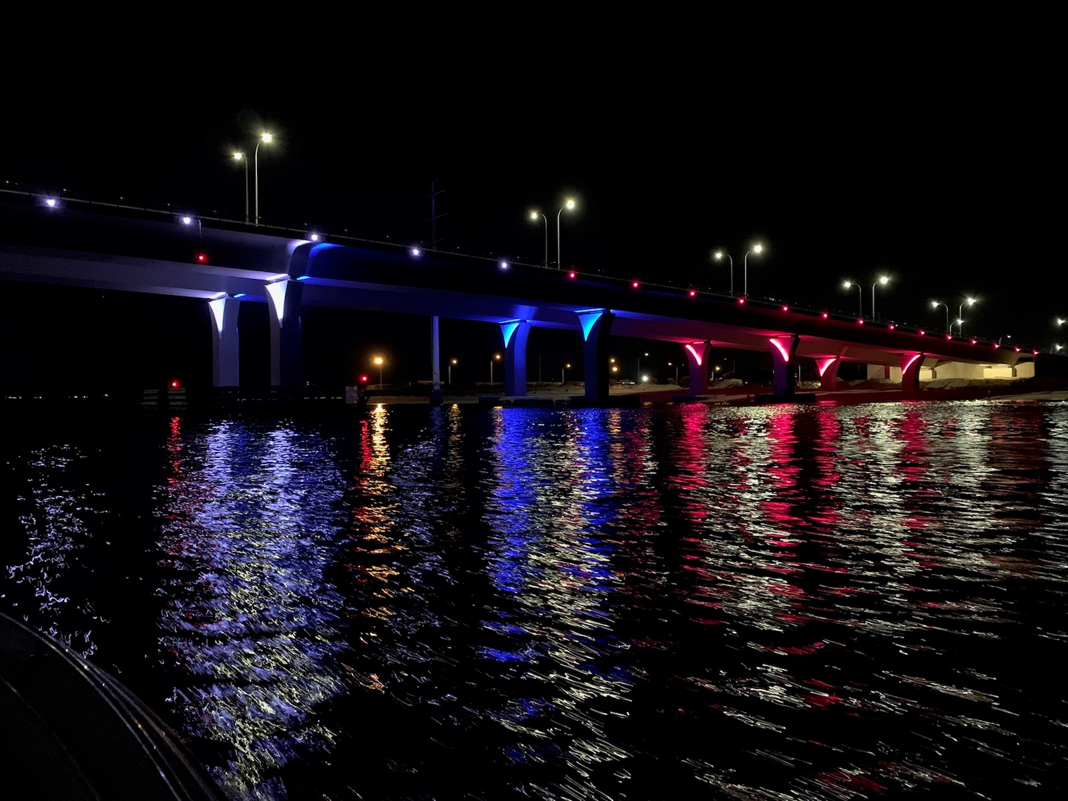
Lesner Bridge Aesthetic Lighting
Programmed Lighting Schemes
(By Philips Lighting)
# | Date Range | Event | Effect |  | # | Date Range | Event | Effect
1 | Jan 1 - Jan 31 |  | Aqua |  | 8 | Jun 14 | Flag Day | Red / White / Blue
1 | Feb 1 - Feb 13 |  | Aqua |  | 1 | Jun 15 |  | Aqua
2 | Feb 14 | Valentines Day | Pink |  | 9 | Jun 16 | Fathers Day | Aqua Necklace / Blue Piers
1 | Feb 15 - Feb 28/29 |  | Aqua |  | 1 | Jun 17 - Jun 30 |  | Aqua
1 | Mar 1 - Mar 16 |  | Aqua |  | 1 | Jul 1 - Jul 3 |  | Aqua
3 | Mar 17 | St. Patricks Day | Lime Green / White Center |  | 10 | Jul 4 | 4th of July | Red / White / Blue Fireworks
4 | Mar 18 - Mar 31 | Spring | Yellow |  | 1 | Jul 5 - Jul 31 |  | Aqua
5 | Apr 1 - Apr 21 | Autism | Light Pink |  | 1 | Aug 1 - Aug 29 |  | Aqua
6 | Apr 22 | Earth Day | Green Necklace / Brown Piers |  | 8 | Aug 30 - Sep 2 | Labor Day | Red / White / Blue
5 | Apr 23 - Apr 30 | Autism | Light Pink |  | 11 | Sep 3 - Sep 30 |  | Yellow Necklace / Orange Piers
1 | May 1 - May 11 |  | Aqua |  | 2 | Oct 1 - Oct 30 | Breast Cancer | Pink
7 | May 12 | Mothers Day | Pink / White |  | 12 | Oct 31 | Halloween | Purple Necklace / Red, Yellow, Orange Piers
1 | May 13 - May 23 |  | Aqua |  | 13 | Nov 1 - Nov 22 | Fall | Red, Yellow, Orange Neckalce / Red, Yellow, Orange Piers
8 | May 24 - May 27 | Memorial Day | Red / White / Blue |  | 14 | Nov 23 - Nov 30 | Thanksgiving | Blue / White
1 | May 28 - May 31 |  | Aqua |  | 14 | Dec 1 - Dec 30 |  | Blue / White
1 | Jun 1 - Jun 13 |  | Aqua |  | 15 | Dec 31 | New Years | Pink / White / Blue

Slide 3
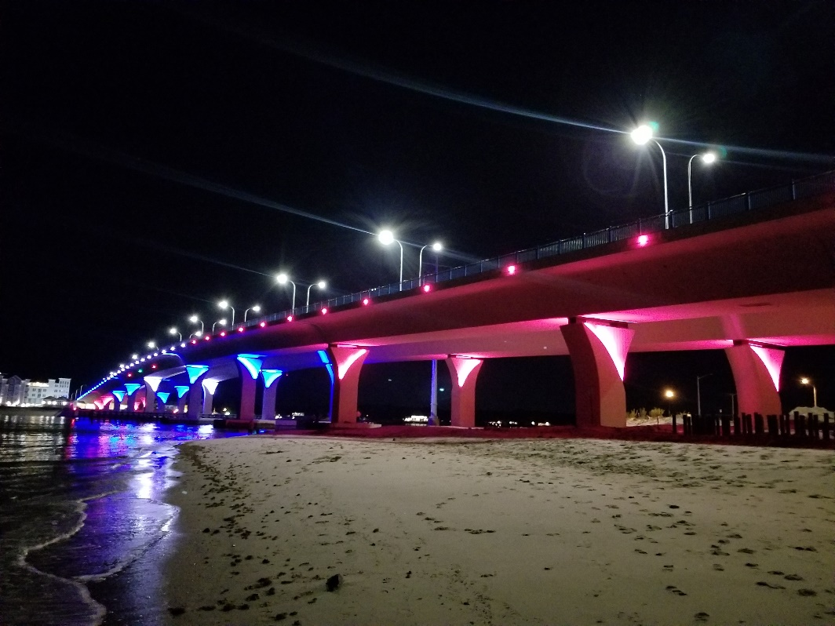
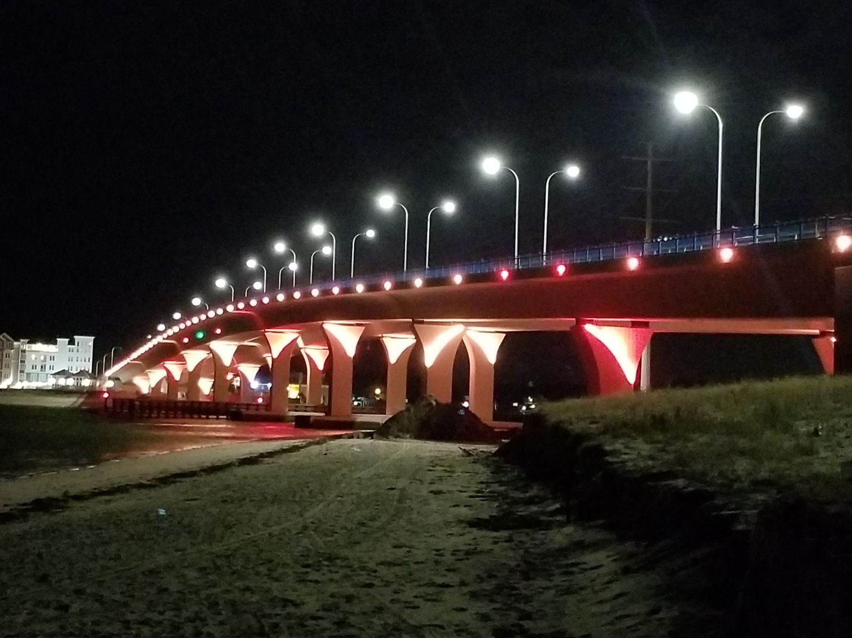
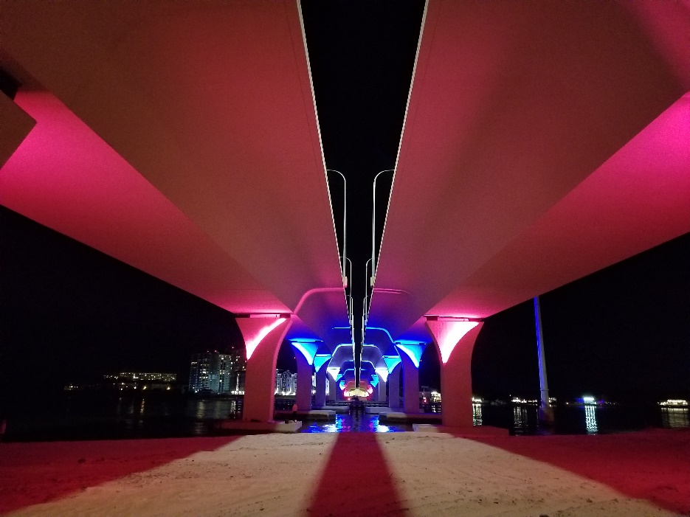
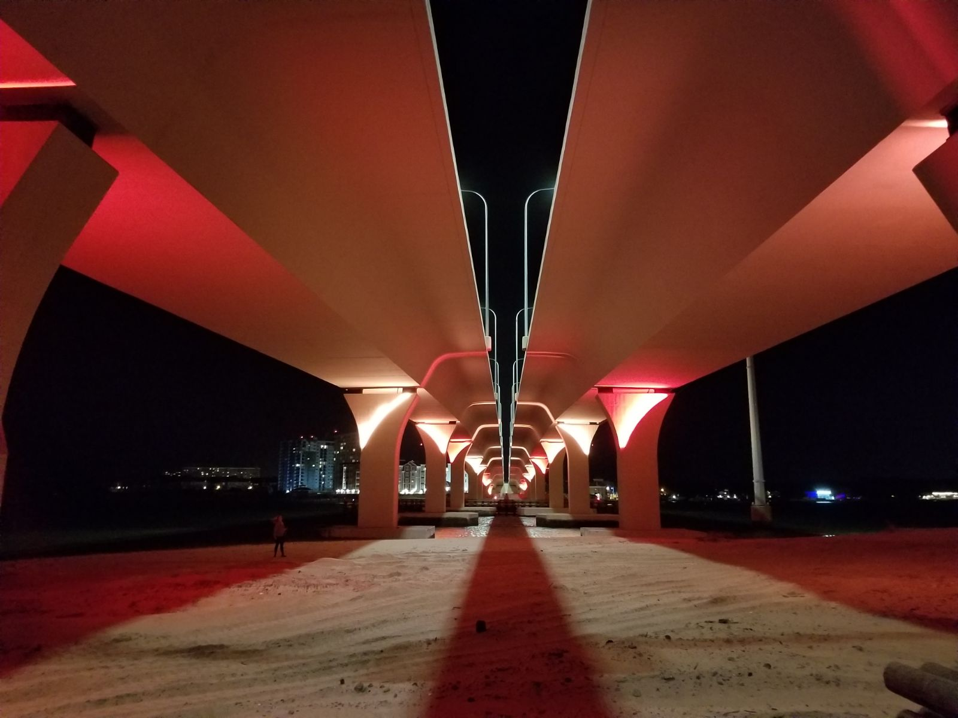
Lesner Bridge – Lighting Schemes

Slide 4
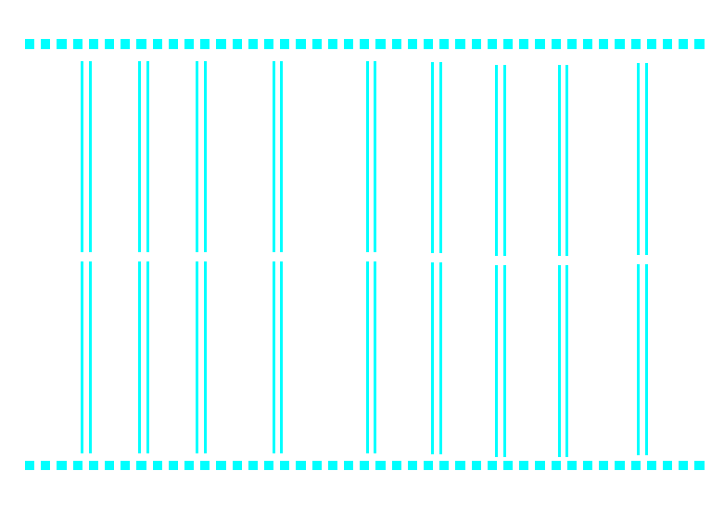
Chesapeake Bay
Necklace Lighting on Edge of WB Bridge
Plan View of WB Bridge Pier Columns
Jan 1 thru Feb 13
Feb 15 thru Mar 16
May 1 thru May 11
May 13 thru May 23
May 28 thru Jun 13
Jun 15
Jun 17 thru Jul 3
July 5 thru Aug 29
Plan View of EB Bridge Pier Columns
Necklace Lighting on Edge of EB Bridge
Lynnhaven River

Slide 5

Chesapeake Bay
Necklace Lighting on Edge of WB Bridge
Plan View of WB Bridge Pier Columns
Feb 14 – Valentines Day
Oct 1 thru Oct 30 – Breast Cancer Awareness
Plan View of EB Bridge Pier Columns
Necklace Lighting on Edge of EB Bridge
Lynnhaven River

Slide 6
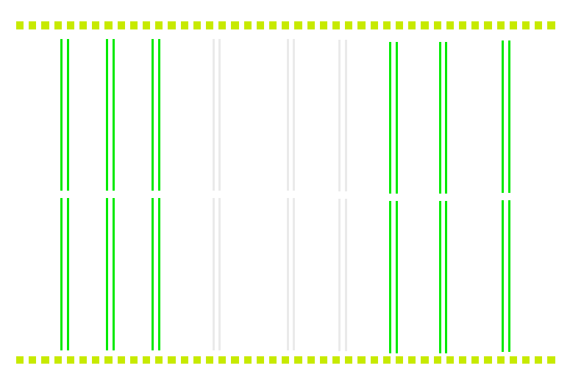
Chesapeake Bay
Necklace Lighting on Edge of WB Bridge
Plan View of WB Bridge Pier Columns
Mar 17 St. Patrick’s Day
Plan View of EB Bridge Pier Columns
Necklace Lighting on Edge of EB Bridge
Lynnhaven River

Slide 7

Chesapeake Bay
Necklace Lighting on Edge of WB Bridge
Plan View of WB Bridge Pier Columns
Mar 18 thru Mar 31
Plan View of EB Bridge Pier Columns
Necklace Lighting on Edge of EB Bridge
Lynnhaven River

Slide 8

Chesapeake Bay
Necklace Lighting on Edge of WB Bridge
Plan View of WB Bridge Pier Columns
Apr 1 thru Apr 21 National Autism Awareness Month
Apr 23 thru Apr 30 National Autism Awareness Month
Plan View of EB Bridge Pier Columns
Necklace Lighting on Edge of EB Bridge
Lynnhaven River

Slide 9
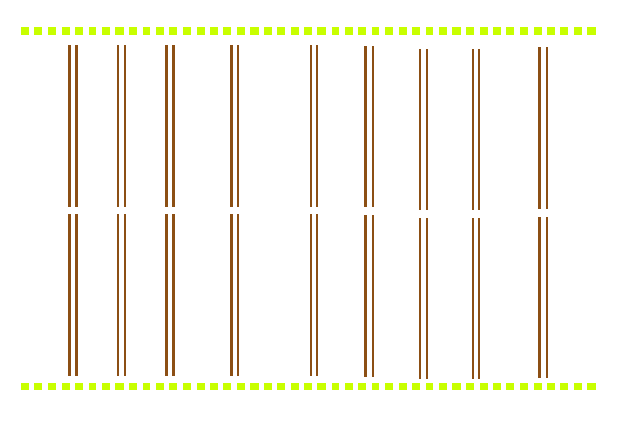
Chesapeake Bay
Necklace Lighting on Edge of WB Bridge
Plan View of WB Bridge Pier Columns
Apr 22 – Earth Day
Plan View of EB Bridge Pier Columns
Necklace Lighting on Edge of EB Bridge
Lynnhaven River

Slide 10

Chesapeake Bay
Necklace Lighting on Edge of WB Bridge
Plan View of WB Bridge Pier Columns
May 12 – Mother’s Day
Plan View of EB Bridge Pier Columns
Necklace Lighting on Edge of EB Bridge
Lynnhaven River

Slide 11
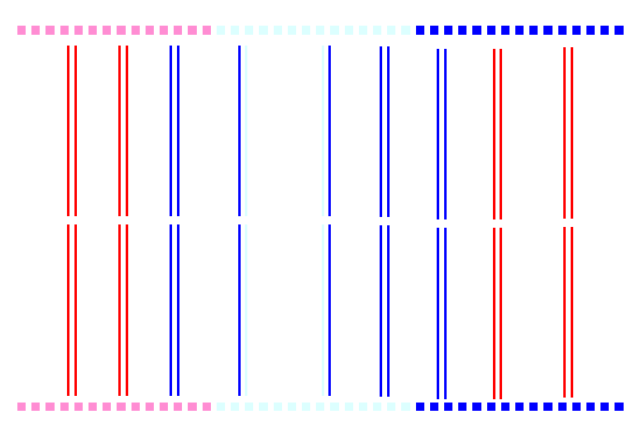
Chesapeake Bay
Necklace Lighting on Edge of WB Bridge
Plan View of WB Bridge Pier Columns
May 24 thru May 27 Memorial Day
Jun 14 Flag Day
Aug 30 thru Sep 2 Labor Day
Plan View of EB Bridge Pier Columns
Necklace Lighting on Edge of EB Bridge
Lynnhaven River

Slide 12
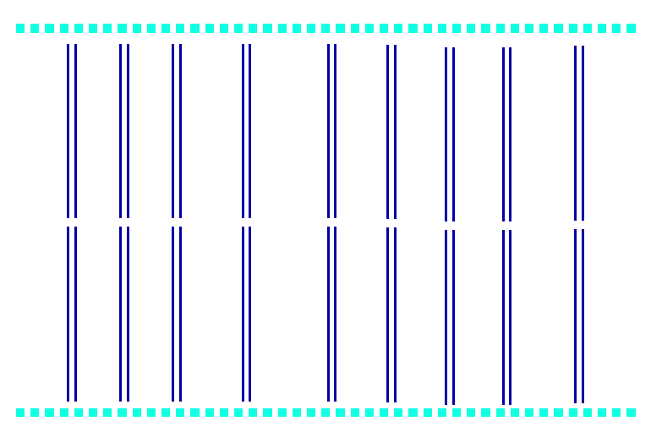
Chesapeake Bay
Necklace Lighting on Edge of WB Bridge
Plan View of WB Bridge Pier Columns
Jun 16 Father’s Day
Plan View of EB Bridge Pier Columns
Necklace Lighting on Edge of EB Bridge
Lynnhaven River

Slide 13
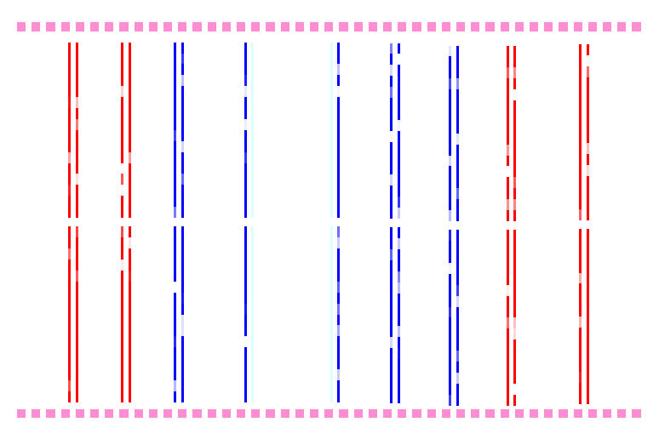
Chesapeake Bay
Necklace Lighting on Edge of WB Bridge
Plan View of WB Bridge Pier Columns
Jul 4 Independence Day
Plan View of EB Bridge Pier Columns
Necklace Lighting on Edge of EB Bridge
Lynnhaven River

Slide 14

Chesapeake Bay
Necklace Lighting on Edge of WB Bridge
Plan View of WB Bridge Pier Columns
Sep 03 thru Sep 30
Plan View of EB Bridge Pier Columns
Necklace Lighting on Edge of EB Bridge
Lynnhaven River

Slide 15
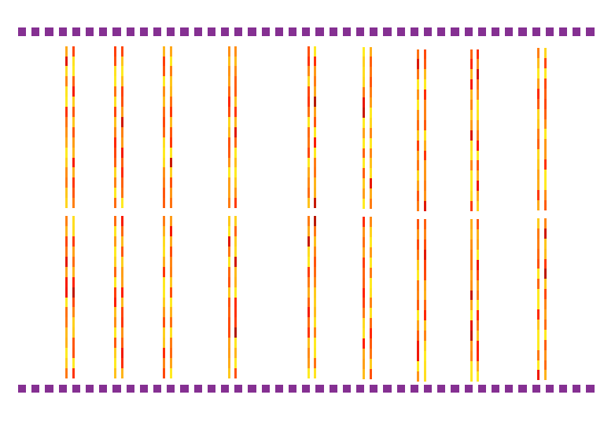
Chesapeake Bay
Necklace Lighting on Edge of WB Bridge
Plan View of WB Bridge Pier Columns
Oct 31 Halloween
Plan View of EB Bridge Pier Columns
Necklace Lighting on Edge of EB Bridge
Lynnhaven River

Slide 16
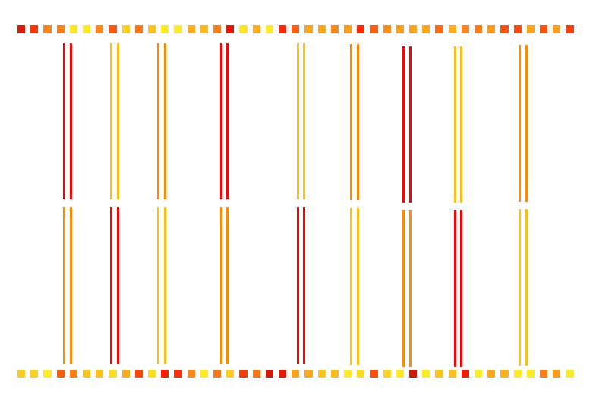
Chesapeake Bay
Necklace Lighting on Edge of WB Bridge
Plan View of WB Bridge Pier Columns
Nov 1 thru Nov 22
Plan View of EB Bridge Pier Columns
Necklace Lighting on Edge of EB Bridge
Lynnhaven River

Slide 17
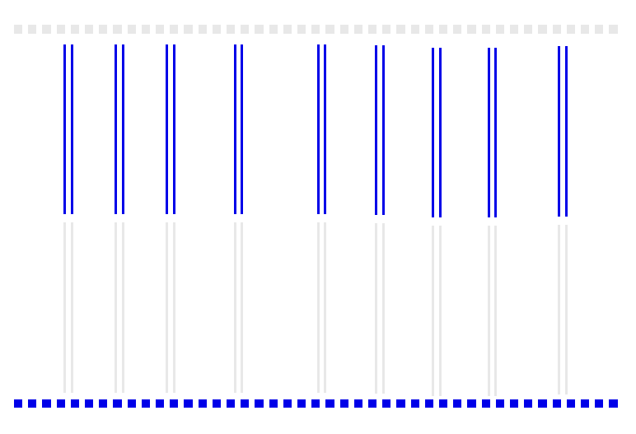
Chesapeake Bay
Necklace Lighting on Edge of WB Bridge
Plan View of WB Bridge Pier Columns
Nov 23 thru Dec 30
Plan View of EB Bridge Pier Columns
Necklace Lighting on Edge of EB Bridge
Lynnhaven River

Slide 18
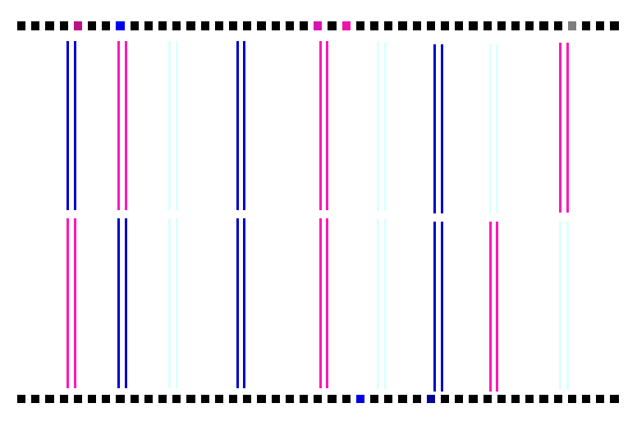
Chesapeake Bay
Necklace Lighting on Edge of WB Bridge
Plan View of WB Bridge Pier Columns
Dec 31 and Jan 1 New Year’s Eve and Day
Plan View of EB Bridge Pier Columns
Necklace Lighting on Edge of EB Bridge
Lynnhaven River

