Slide 1
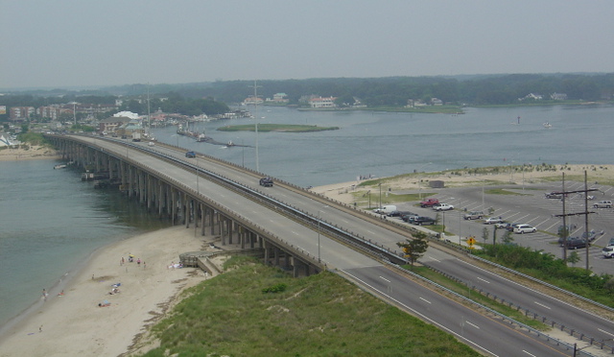


LESNER BRIDGE REPLACEMENT PROJECT
Shore Drive Community Coalition Meeting
January 27, 2014
Christopher Wojtowicz, P.E.
City of Virginia Beach
Department of Public Works
City Engineer’s Office
Transportation Division

Slide 2
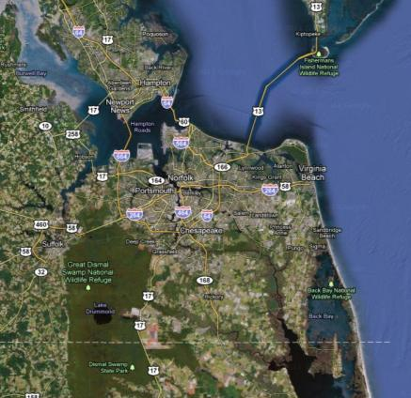
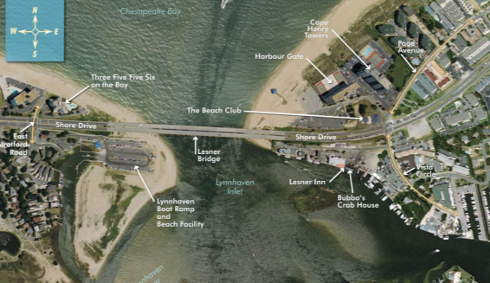
Lesner Bridge Replacement
Project Location

Slide 3
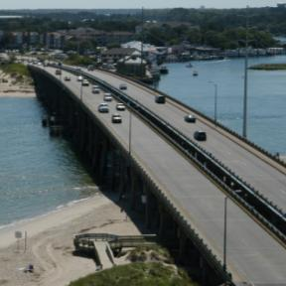
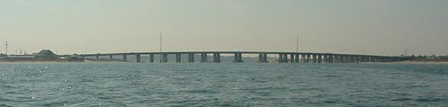
Lesner Bridge Replacement
Existing Bridge
  1530 ft long twin bridges
  EB built 1958, WB built 1967
  28 spans: 25 concrete, 3 steel
  Corridor carries ~43,000 vpd

Slide 4
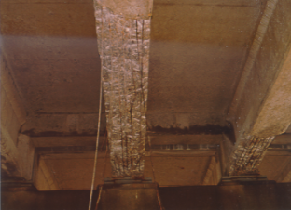
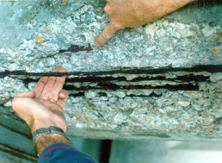
Lesner Bridge Replacement
Background
  Bridges were built in early days of prestressed concrete
  Salt environment has corroded steel strands
  Corrosion can not be stopped; only slowed with diligent maintenance

Slide 5
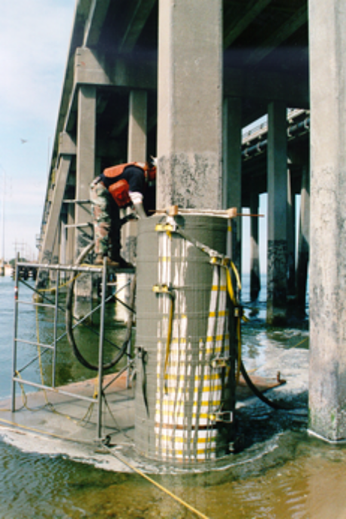
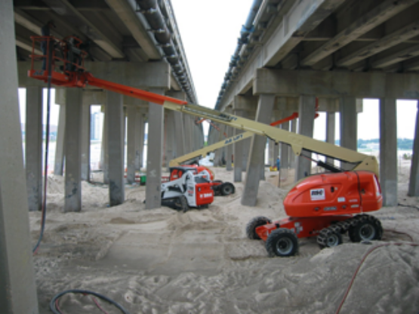
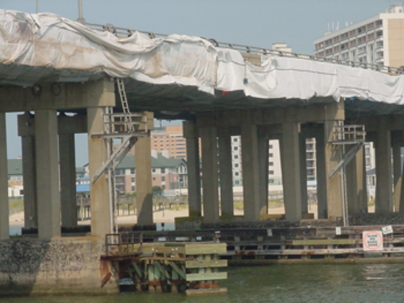
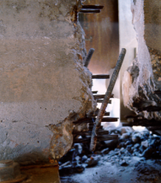
Lesner Bridge Replacement
Background
  Other repairs include pile jacketing, beam end repairs, and steel painting
  Current sufficiency ratings for the bridges are 34.9 (WB) and 39.0 (EB)

Slide 6
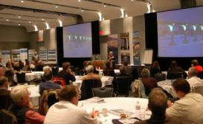
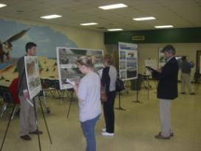
Lesner Bridge Replacement
Design
  Design team of Figg Engineering/Clark-Nexsen was chosen in 2005
  Provide a signature bridge that reflects the surrounding community
  Extensive public involvement including Listening Tours, Design Charette & Citizen Information Meetings
  Community input on bridge theme, shapes, aesthetics, lighting, and other amenities

Slide 7
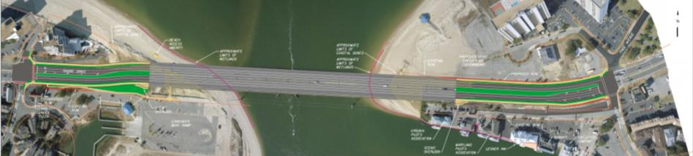
Lesner Bridge Replacement
Design Challenges
  Maintain 4 lanes of traffic during construction
  Tie-in at existing intersections
  Limiting r/w impacts based on chosen alignment

Slide 8
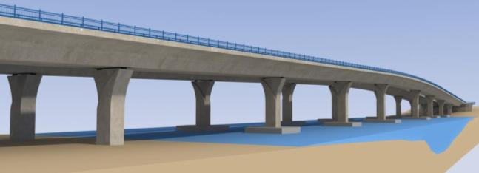
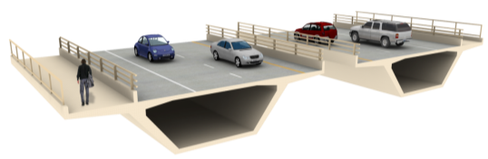
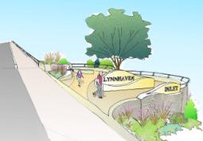
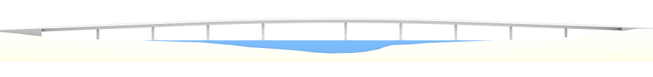
Lesner Bridge Replacement
Design
150’ (typ)
225’ main span

Slide 9
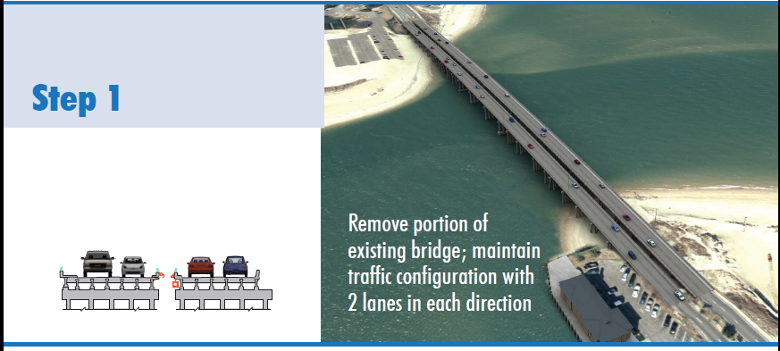
Lesner Bridge Replacement
Construction Staging

Slide 10
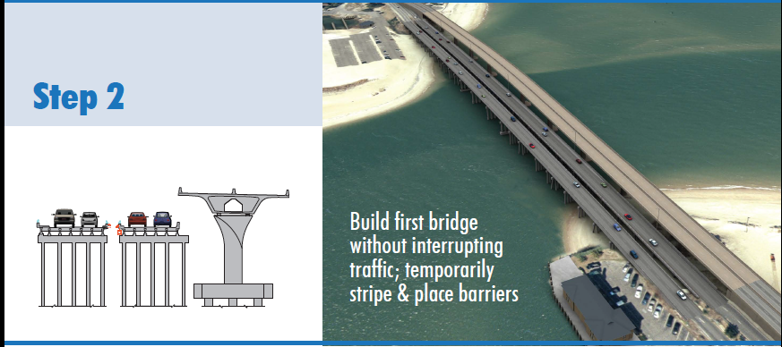
Lesner Bridge Replacement
Construction Staging

Slide 11
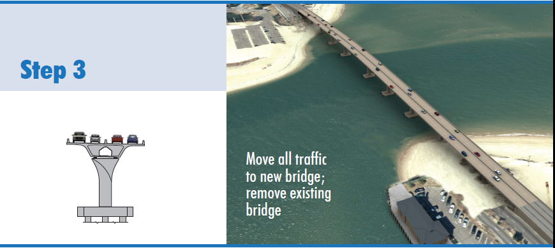
Lesner Bridge Replacement
Construction Staging

Slide 12
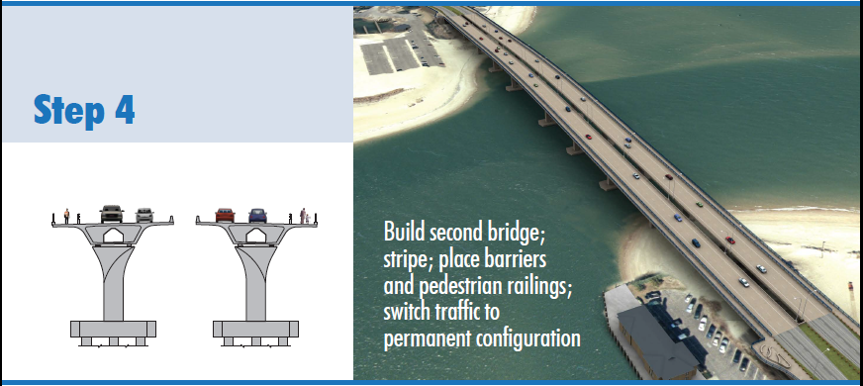
Lesner Bridge Replacement
Construction Staging

Slide 13
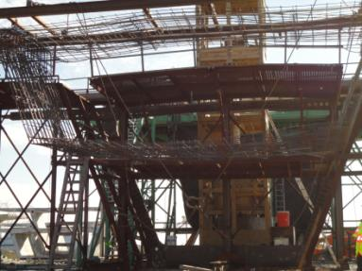
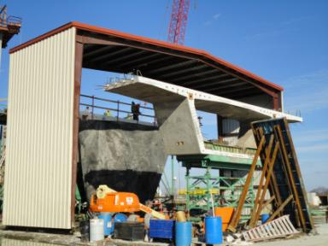
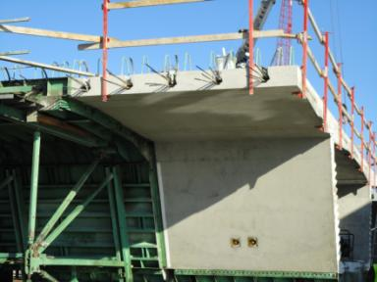
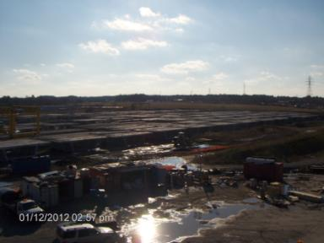
Casting Yard (Jordan Bridge)

Slide 14
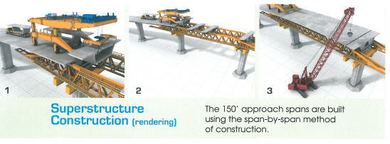
Span-by-Span Construction

Slide 15
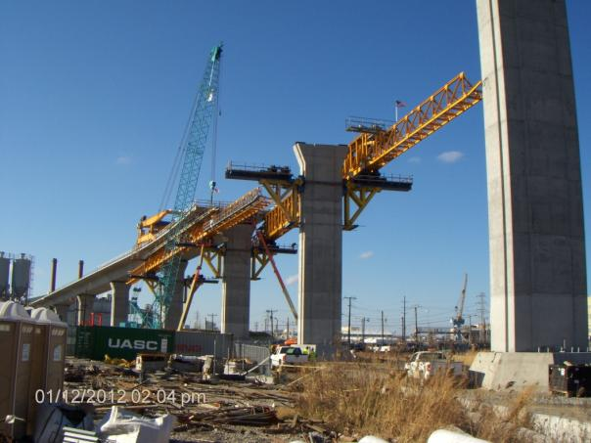
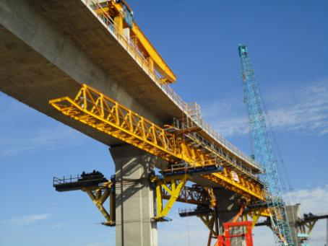
Construction (Jordan Bridge)

Slide 16
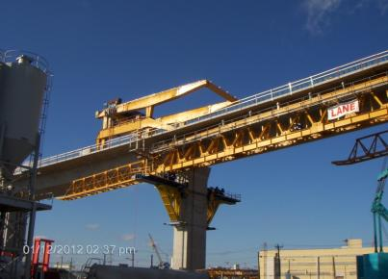
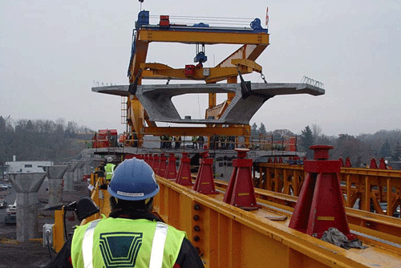
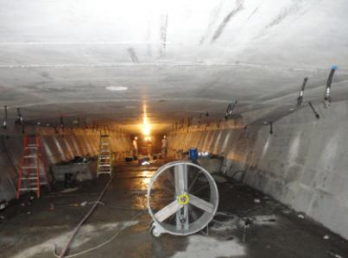
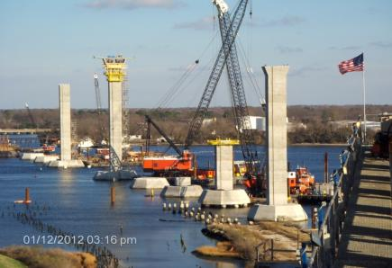
Construction (Jordan Bridge)

Slide 17
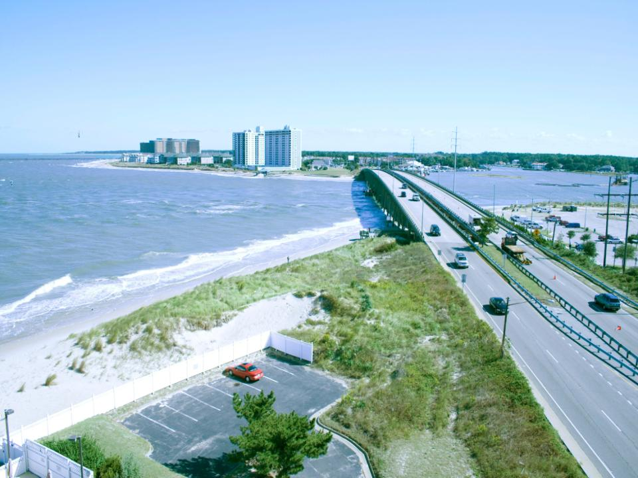
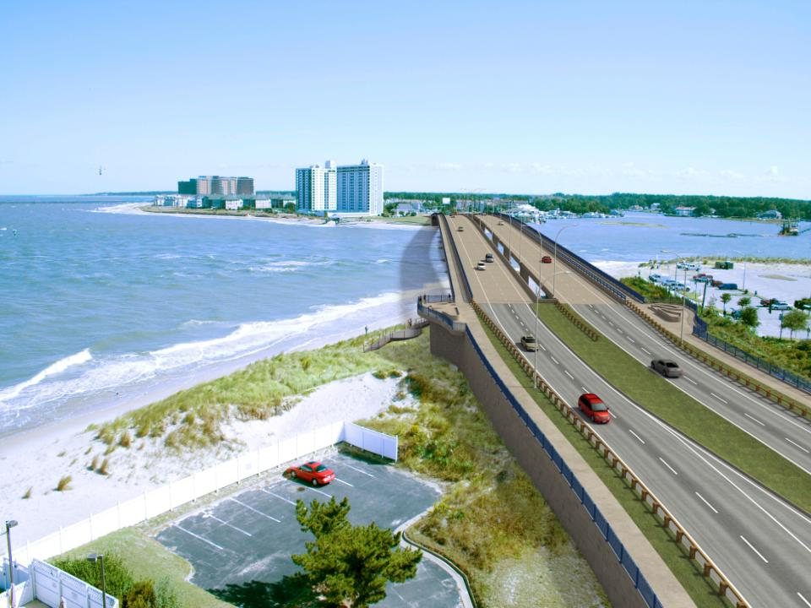

Slide 18
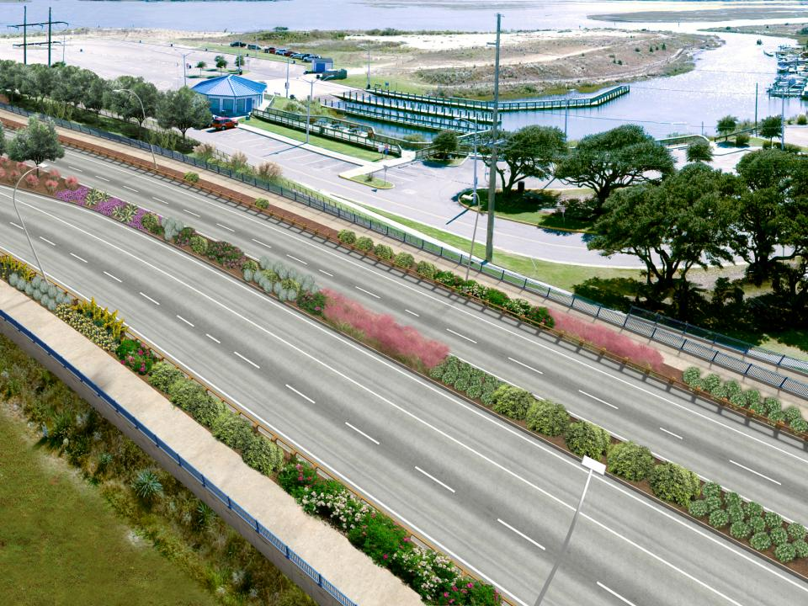
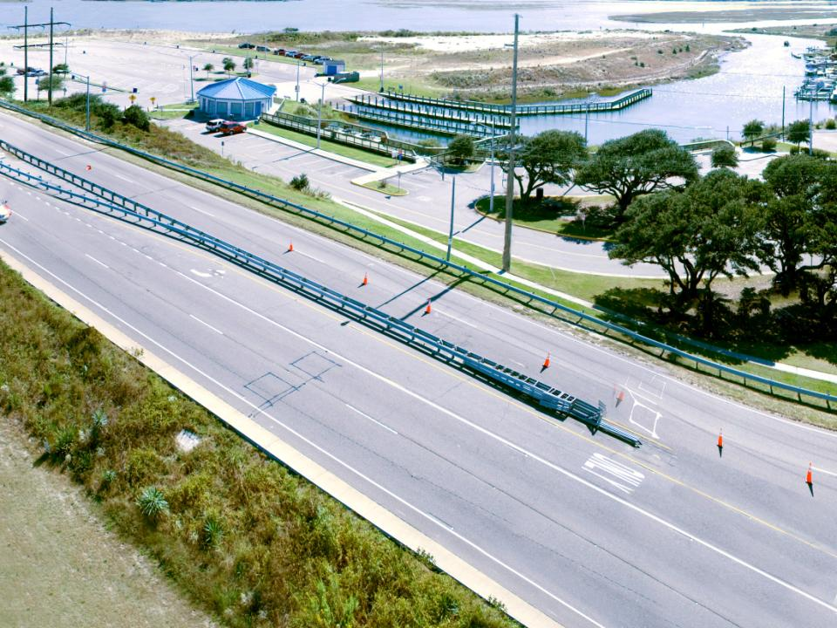

Slide 19
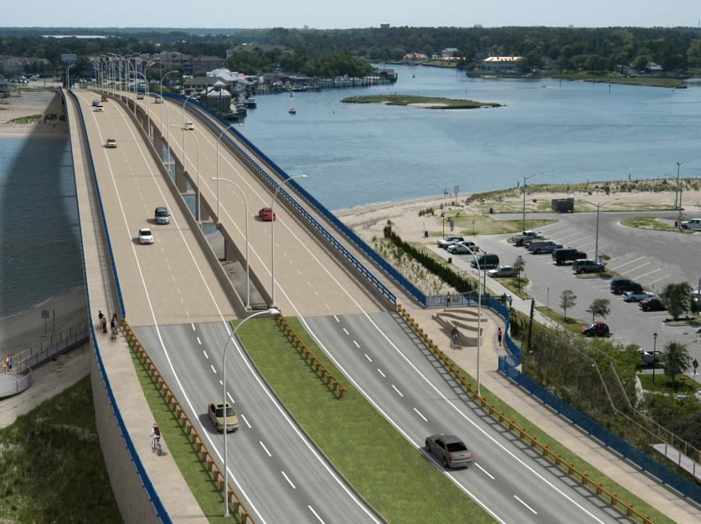
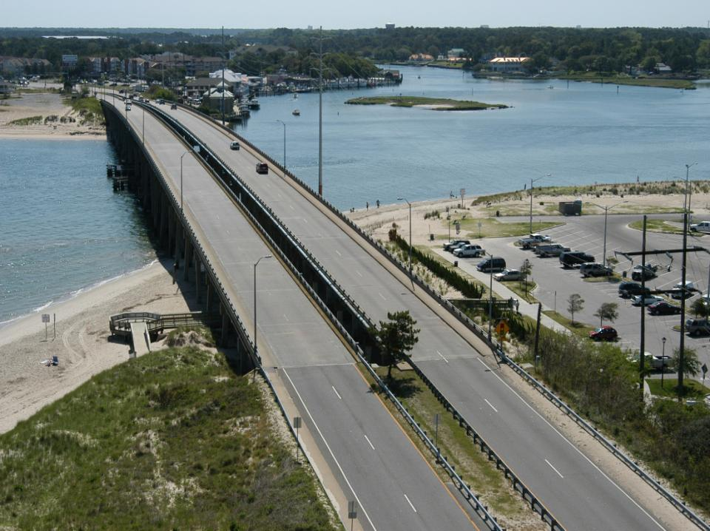

Slide 20
Lesner Bridge Replacement
Project Status
  Project is fully funded
  Environmental process is complete
  Public participation is complete
  All Construction Permits are in place
  Construction bids were opened Dec 20, 2013
  Some discrepancies with low bid, City is working with VDOT/FHWA to address issues

Slide 21
Lesner Bridge Replacement
Funding
  Total project cost: $95 million
    Design: $10.2 million (City funded)
    RW/Utilities: $14.3 million
    Construction: $70.5 million
Schedule
  Notice to Proceed April 2014
  Construction scheduled to take 36 months

Slide 22
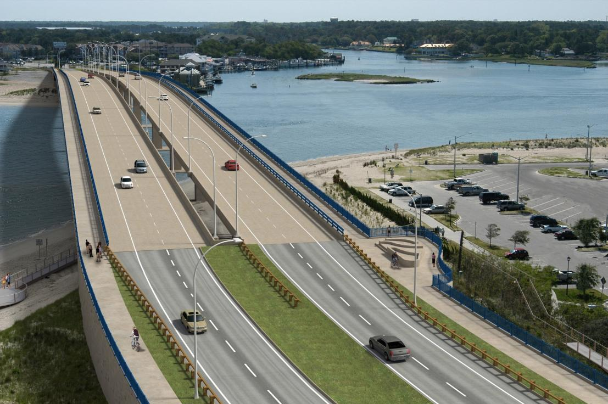
Questions?

